Slide 1
Powerpoint Presentation
Of
Customer Retention
Problem statement
Understanding, EDA steps and visualizations
Steps and assumptions used to complete the project
Analysis, and conclusion.

Slide 2
Problem Statement:
Customer satisfaction has emerged as one of the most important factors that guarantee the success of online store; it has been posited as a key stimulant of purchase, repurchase intentions and customer loyalty. A comprehensive review of the literature, theories and models have been carried out to propose the models for customer activation and customer retention. Five major factors that contributed to the success of an e-commerce store have been identified as: service quality, system quality, information quality, trust and net benefit. The research furthermore investigated the factors that influence the online customers repeat purchase intention. The combination of both utilitarian value and hedonistic values are needed to affect the repeat purchase intention (loyalty) positively. The data is collected from the Indian online shoppers. Results indicate the e-retail success factors, which are very much critical for customer satisfaction.

Slide 3
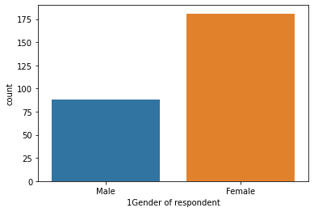
Gender of respondent
Notes:
We can see that there are more female customers than male customers

Slide 4
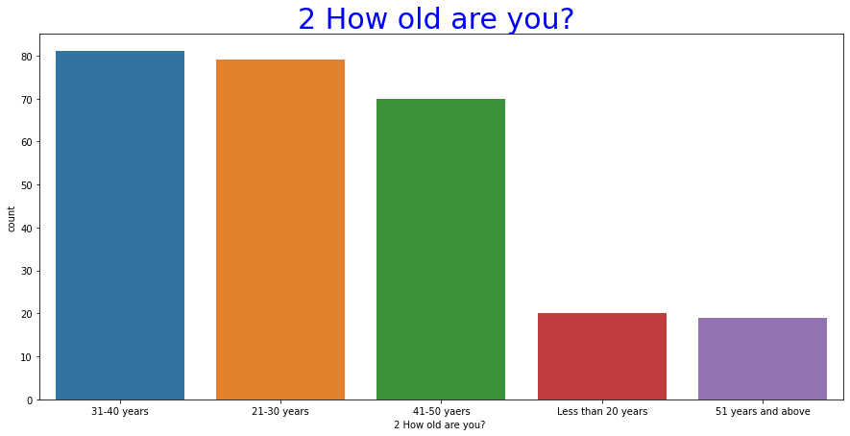
Graph of customer's age

Slide 5
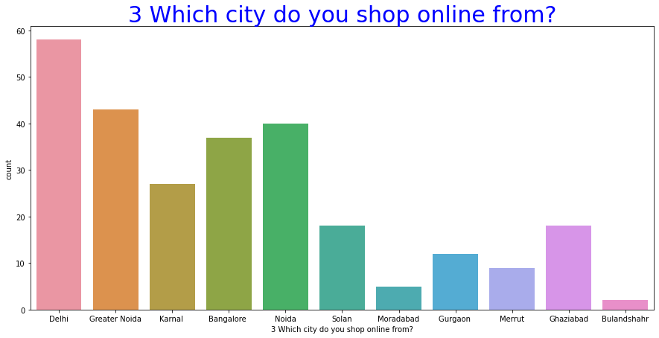
Customer retention-Shoping City Analysis:-

Slide 6
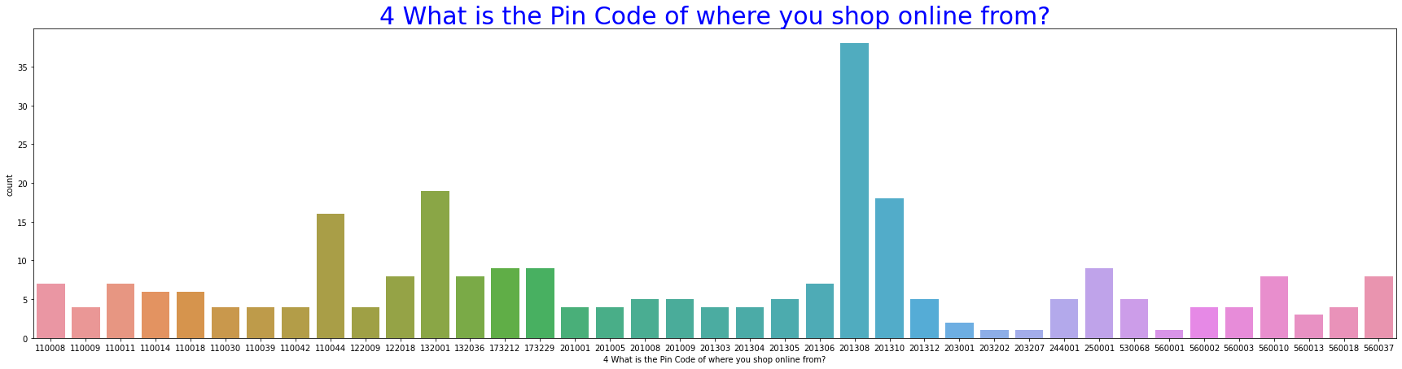
Customer Retention – Pincode Analysis:-

Slide 7
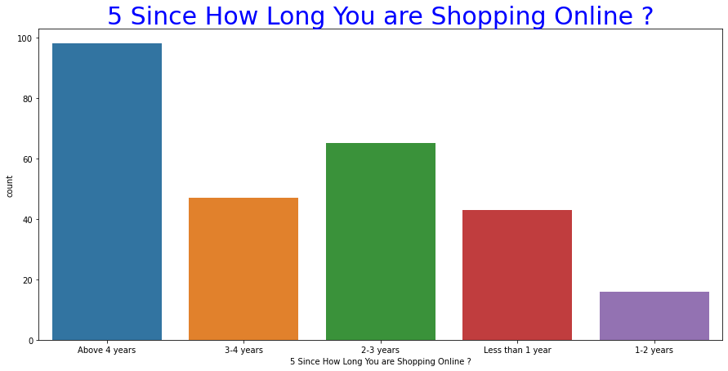
Customer Retention – Shoping Time Analysis:-

Slide 8
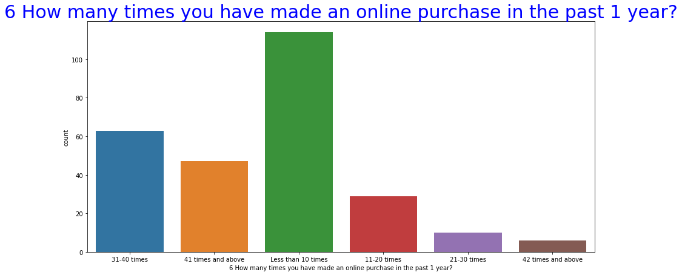
Customer Retention – Online Purchase In 1 Online Purchase In 1 Year Analysis:-

Slide 9
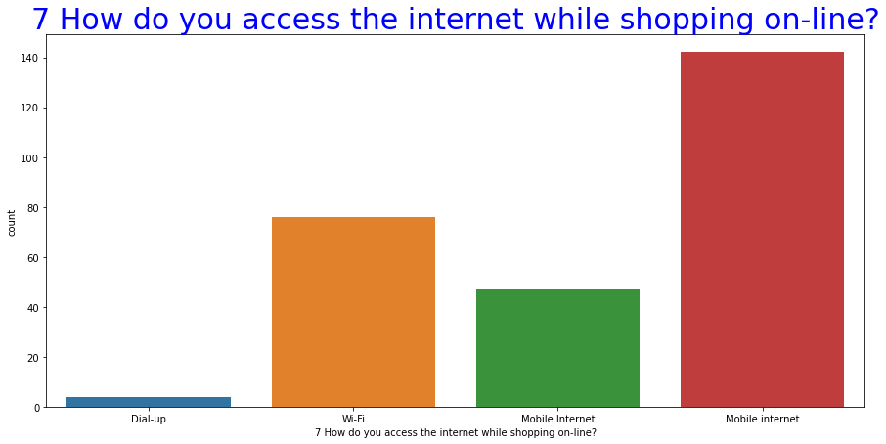
Customer Retention – Accessing Internet Analysis:-

Slide 10
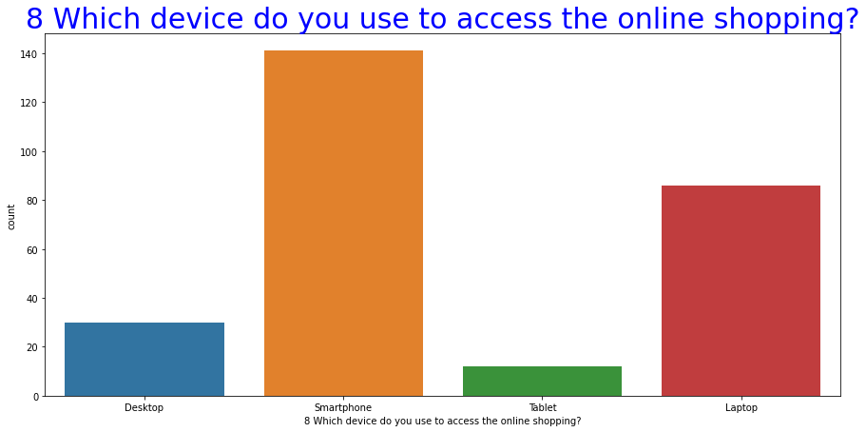
Customer Retention – Device Analysis:-

Slide 11
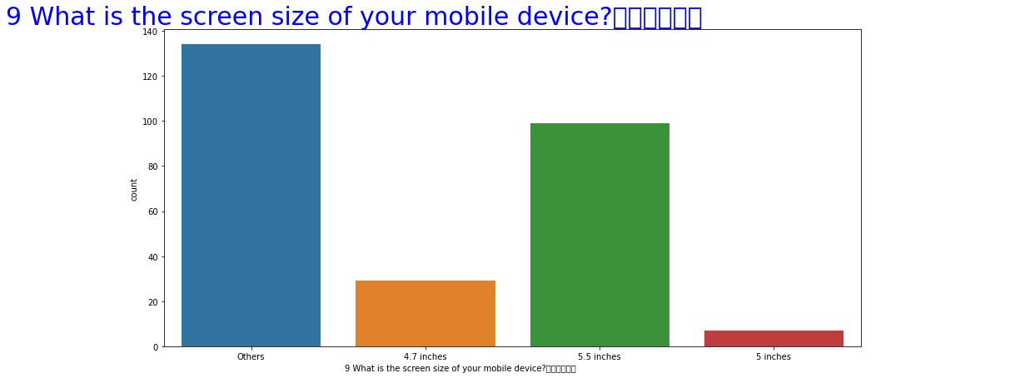
Customer Retention – Pincode Analysis:-

Slide 12
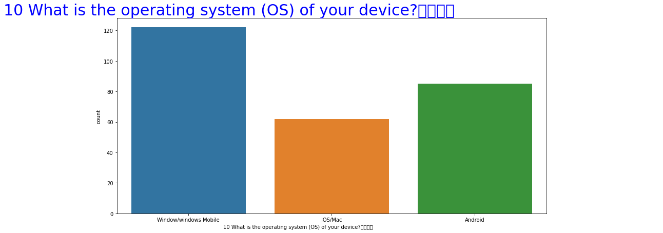
Customer Retention – Operating System Time Analysis:-

Slide 13
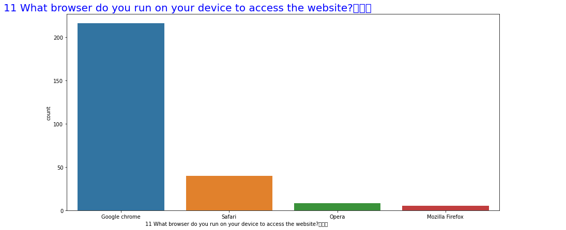
Customer Retention – Browser Analysis:-

Slide 14
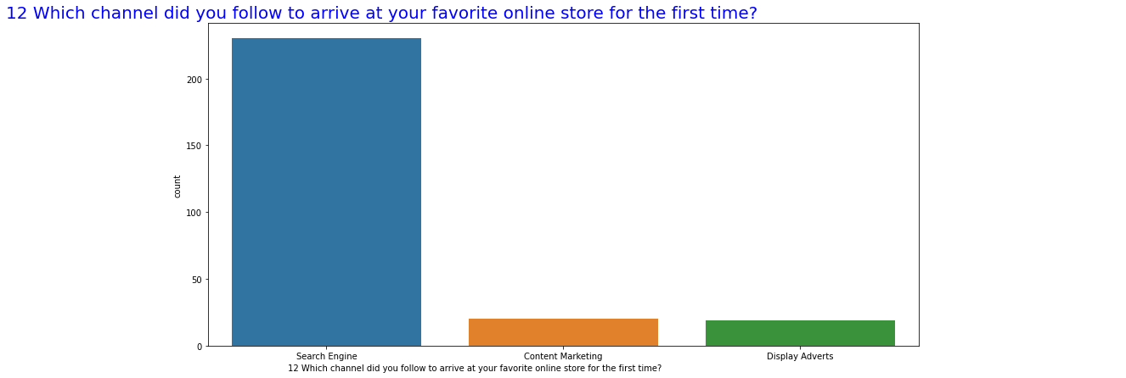
Customer Retention – Favourit Online Store Analysis:-

Slide 15
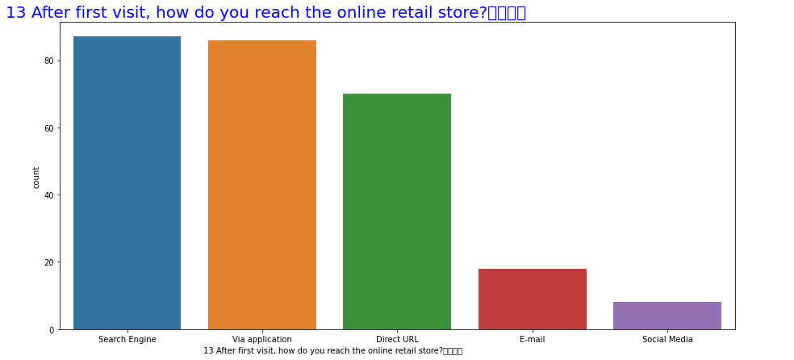
Customer Retention – Purchase Decision Analysis:-

Slide 16
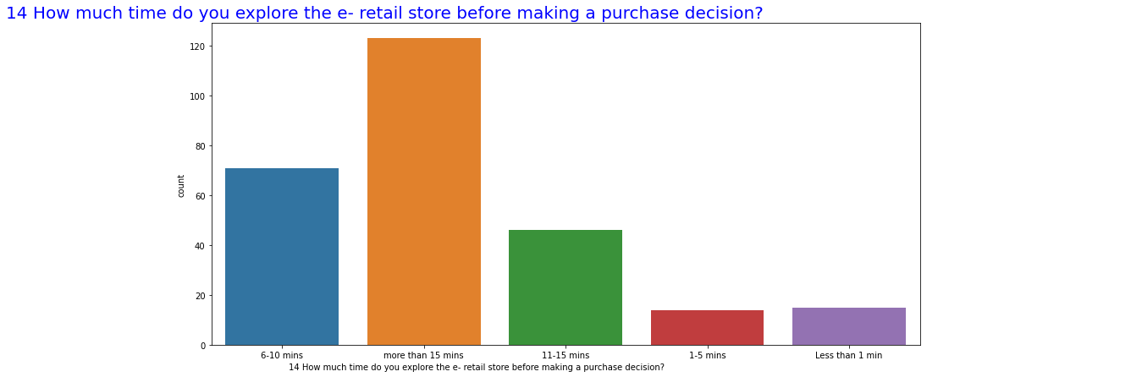
Customer Retention – Purchase Decision Analysis:-

Slide 17
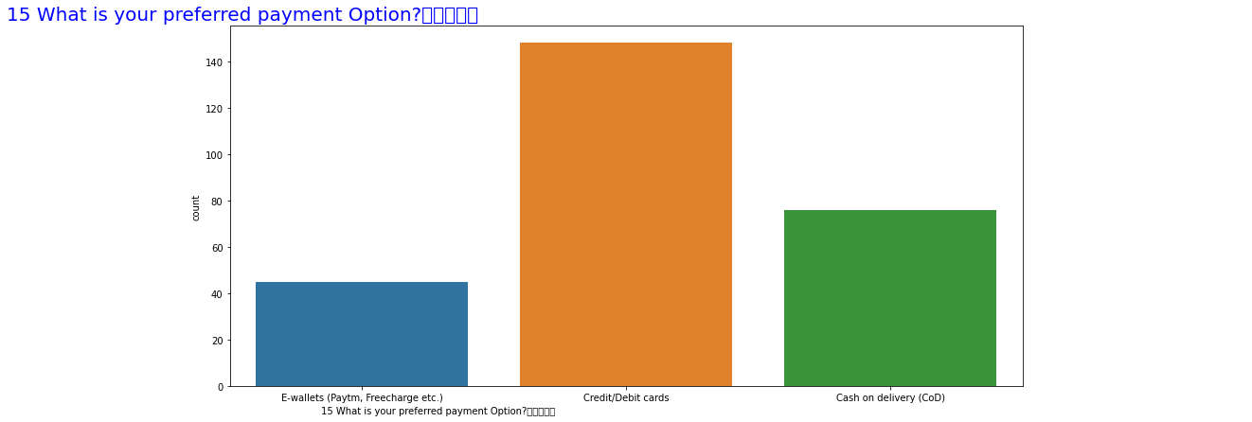
Customer Retention – Payment Option Analysis:-

Slide 18
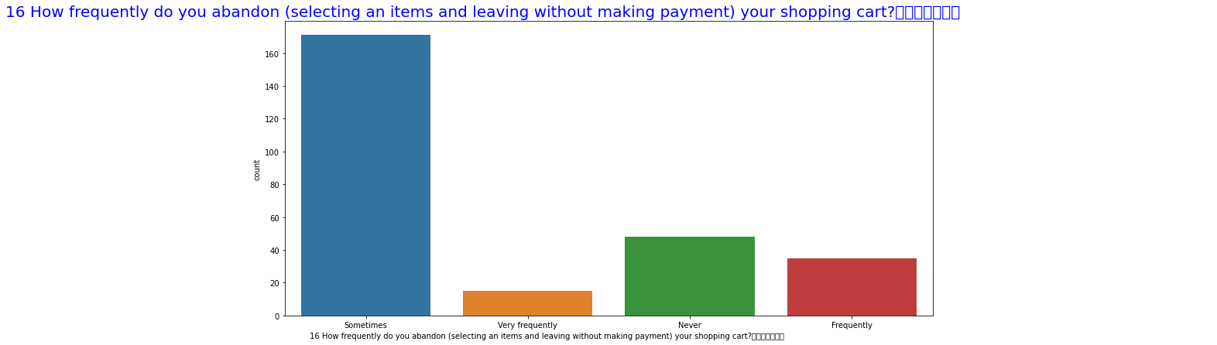
Customer Retention – Shoping Cart Analysis:-

Slide 19
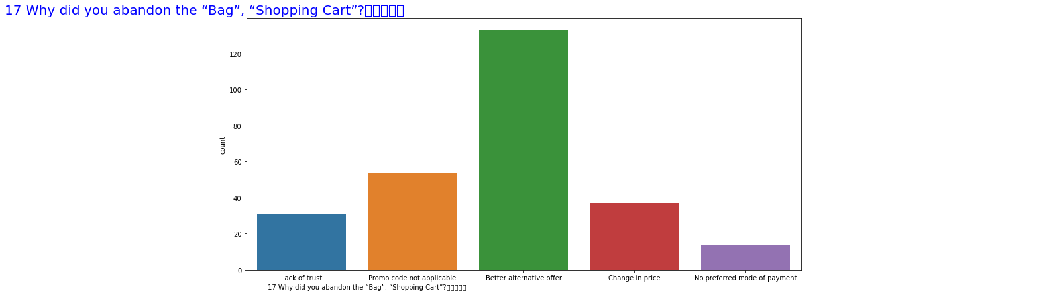
Customer Retention – Abandon Shoping Cart Analysis:-

Slide 20
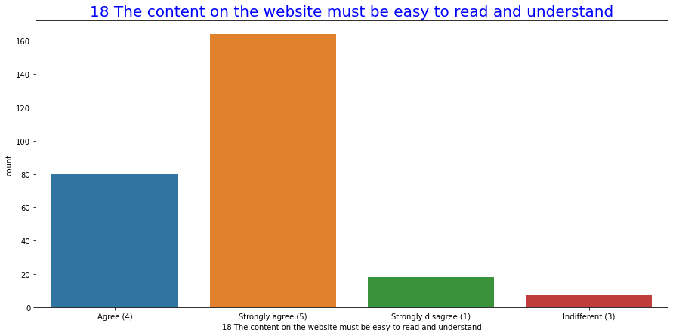
Customer Retention – Website Analysis:-

Slide 21
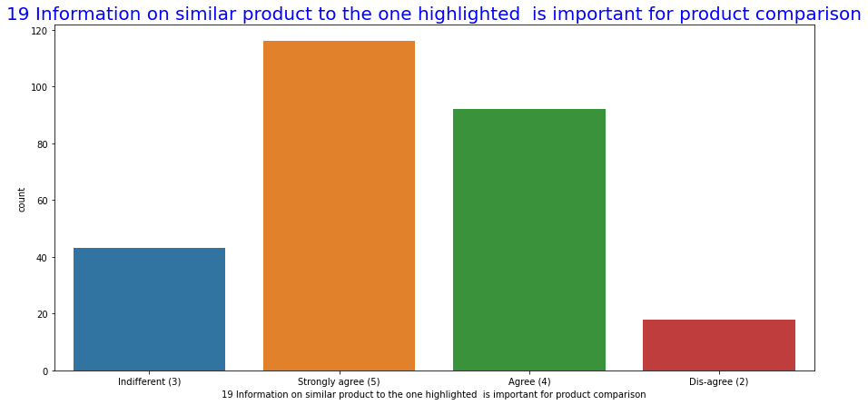
Customer Retention – Product Comparison Analysis:-

Slide 22
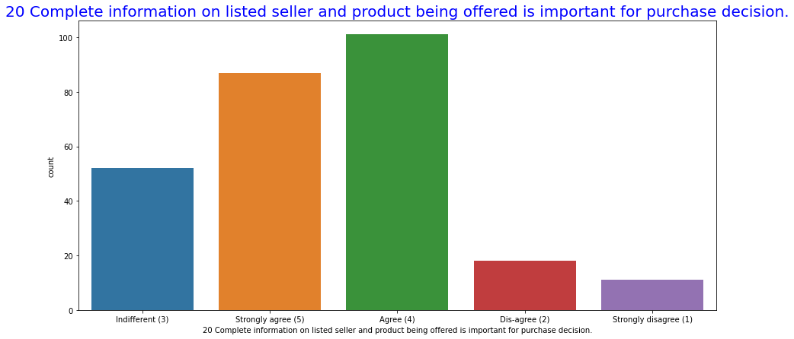
Customer Retention – Purchase Decision Analysis:-

Slide 23
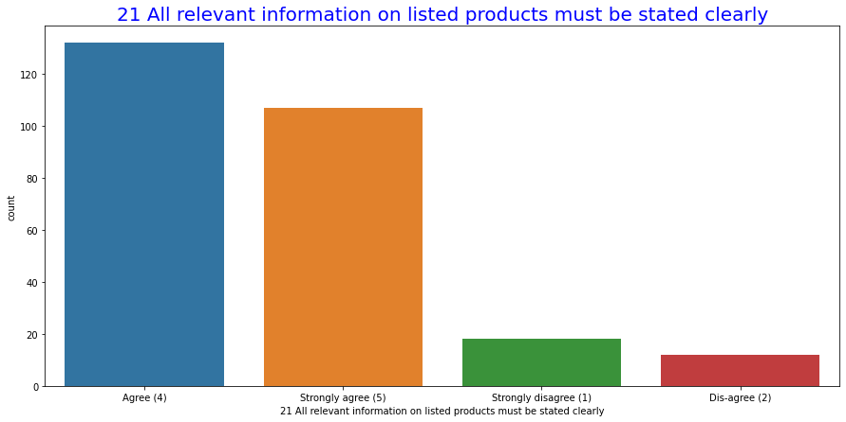
Customer Retention – Relevant Information Analysis:-

Slide 24
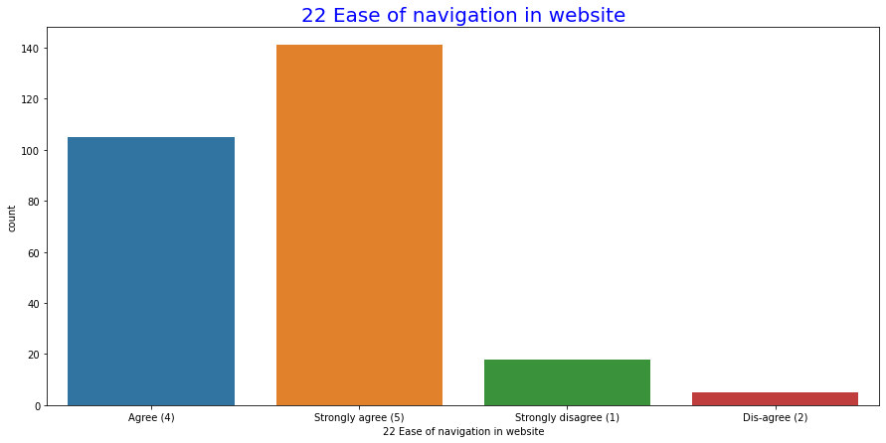
Customer Retention – Ease of Navigation In website Analysis:-

Slide 25
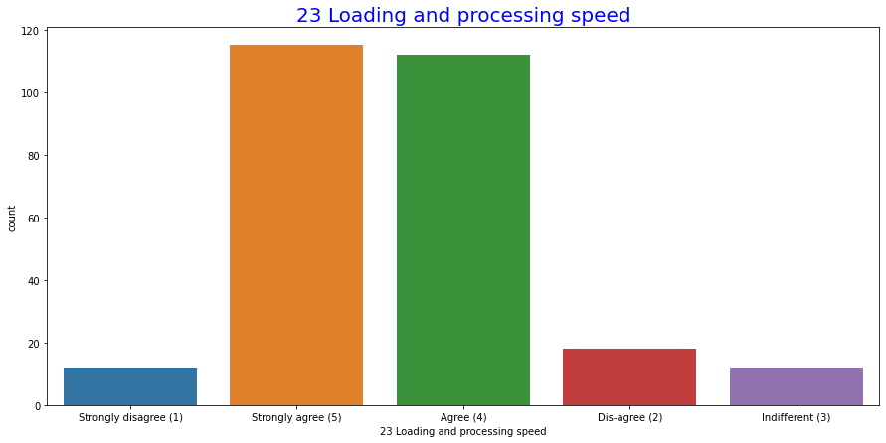
Customer Retention – Loading And Processing Speed Analysis:-

Slide 26
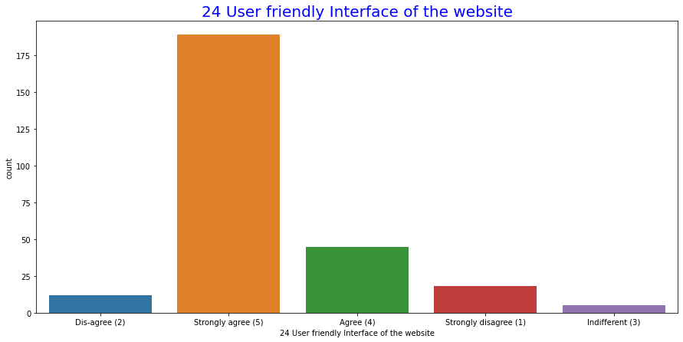
Customer Retention – User Friendly InterFace of The Website Analysis:-

Slide 27
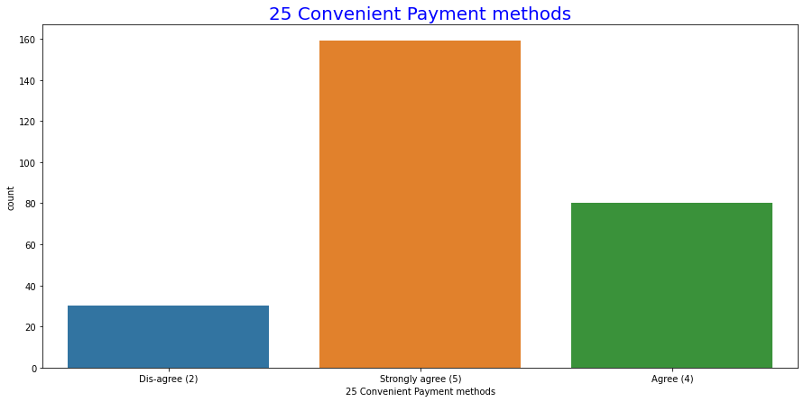
Customer Retention – Payment Method Analysis:-

Slide 28
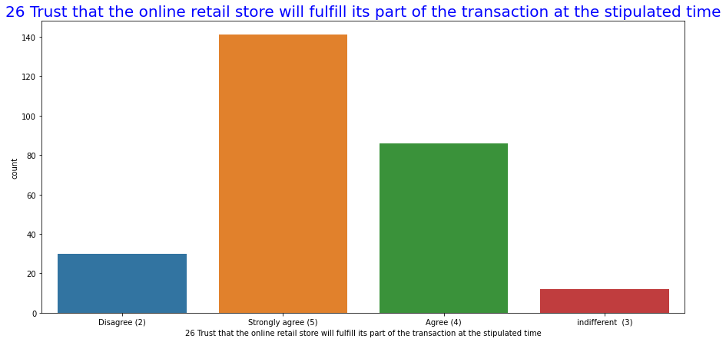
Customer Retention – Transuction Time Analysis:-

Slide 29
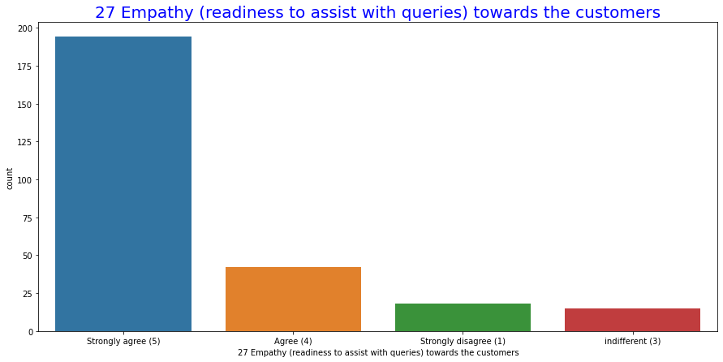
Customer Retention – Empathy Towords the Customer Analysis:-

Slide 30
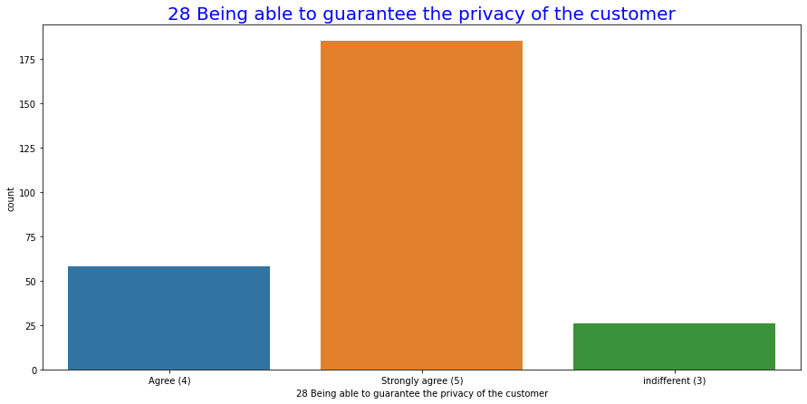
Customer Retention – Privacy of The Customer Analysis:-

Slide 31
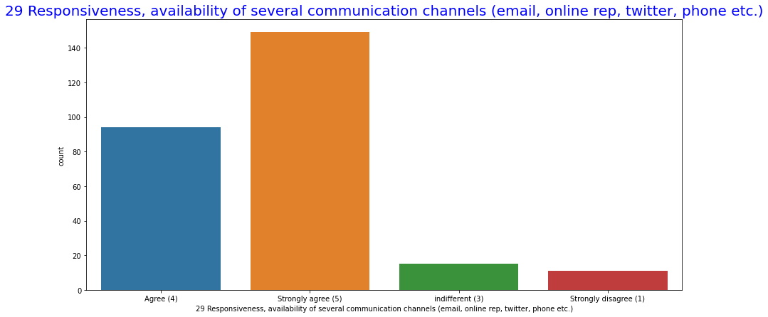
Customer Retention – Communication Channels Analysis:-

Slide 32
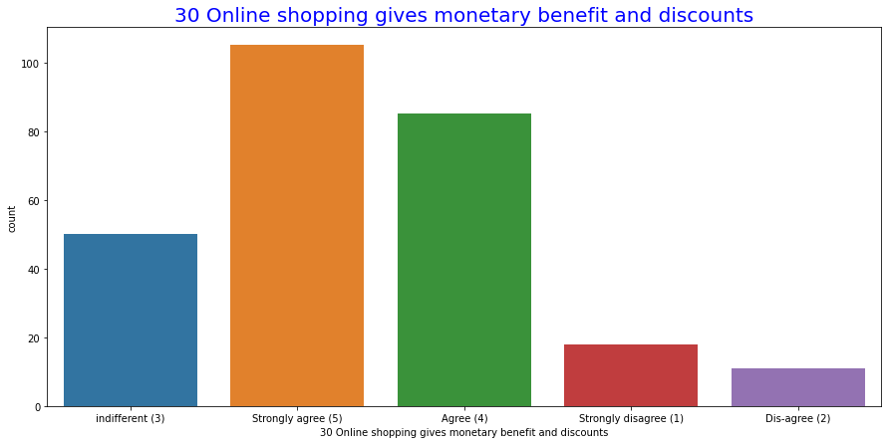
Customer Retention – Benefit And Discount Analysis:-

Slide 33
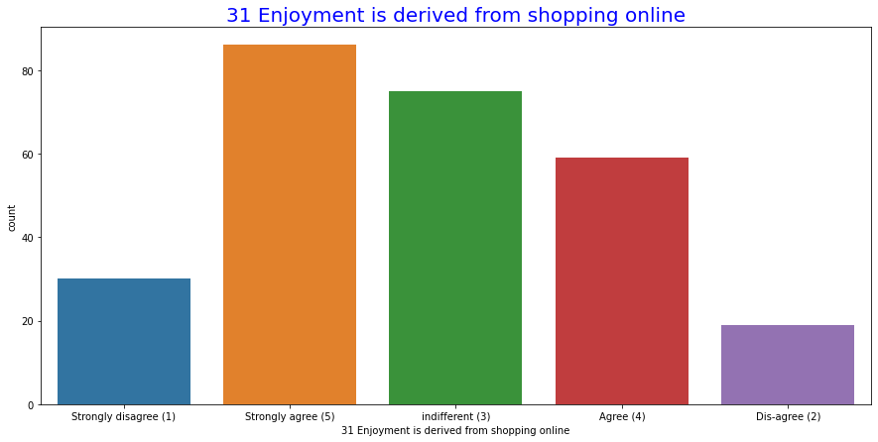
Customer Retention – Shoping Enjoyment Analysis:-

Slide 34
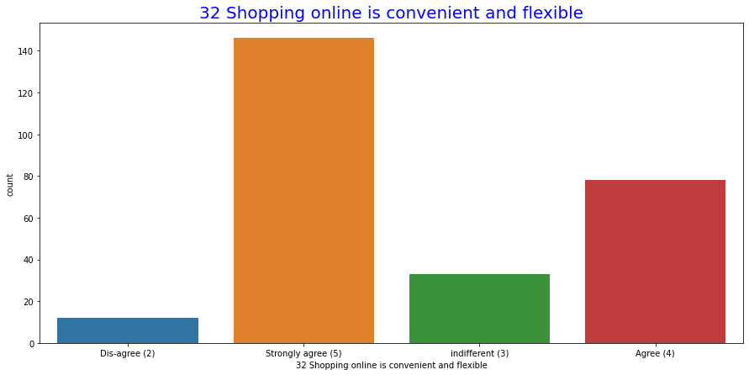
Customer Retention – Shoping Online Convenient And Flexible Analysis:-

Slide 35
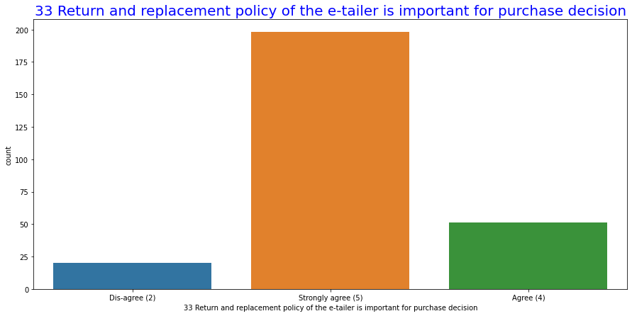
Customer Retention – Return And Replacement Analysis:-

Slide 36
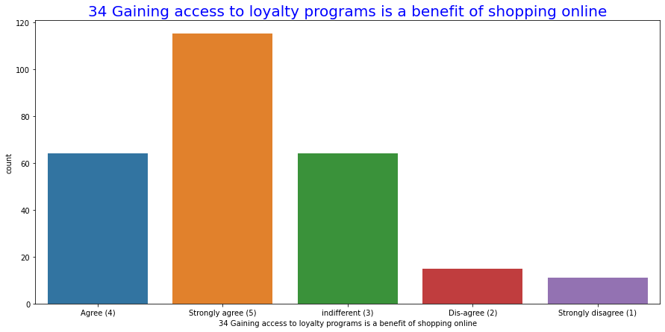
Customer Retention – Online Shoping Benefit Analysis:-

Slide 37
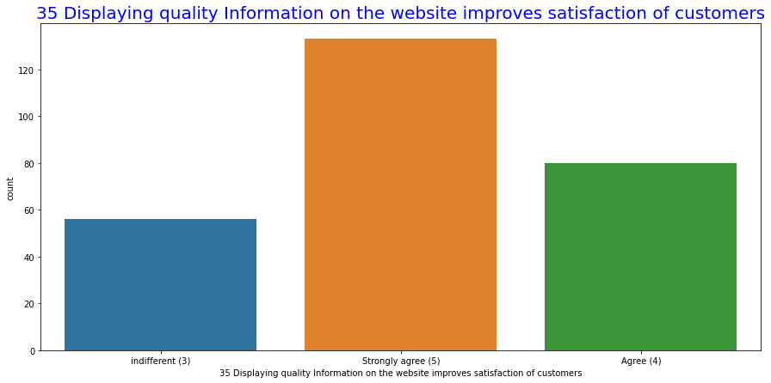
Customer Retention – Display Quality Satisfaction Analysis:-

Slide 38
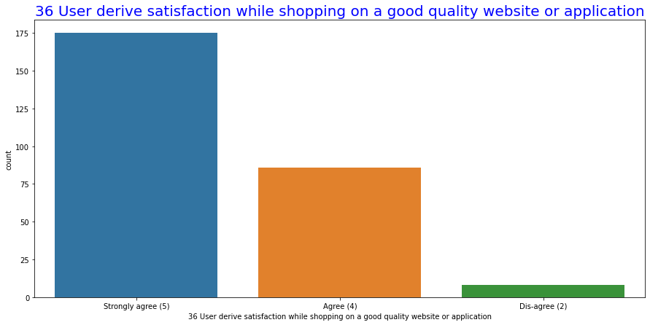
Customer Retention – Derive Satisfaction While Shoping On a Good Qualit Web Or App Analysis:-

Slide 39
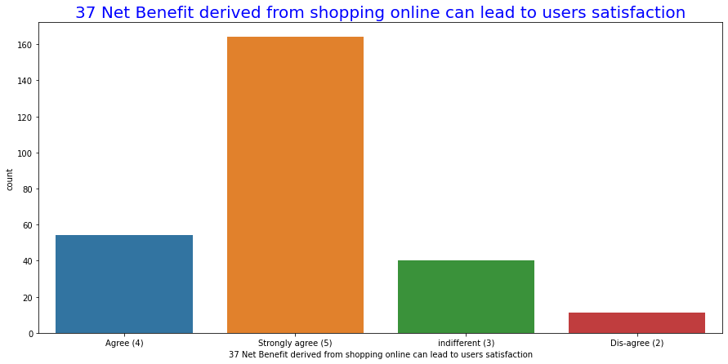
Customer Retention – Net Benefit Analysis:-

Slide 40
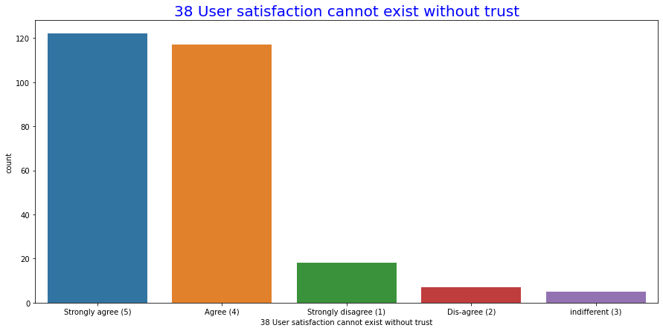
Customer Retention – User Satisfaction Analysis:-

Slide 41
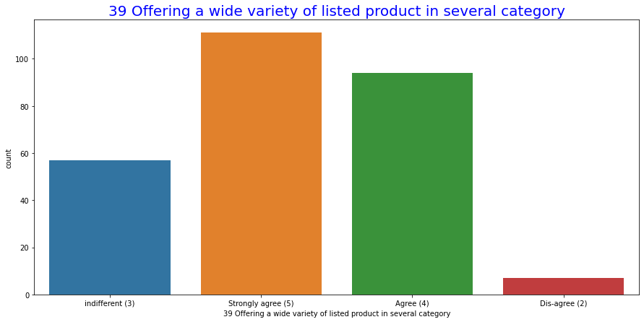
Customer Retention – Several Category Product Offer Analysis:-

Slide 42
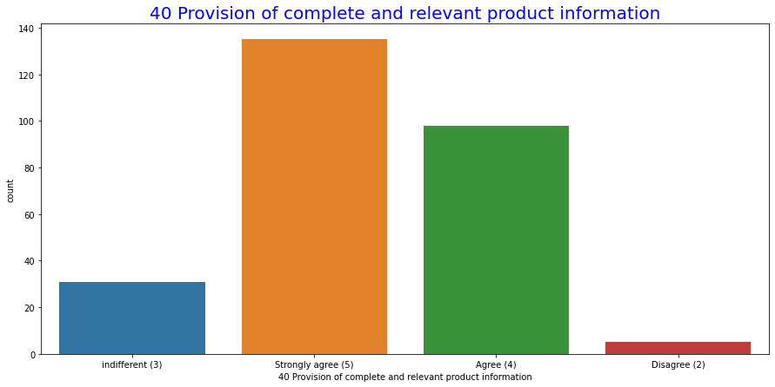
Customer Retention – Provision Of Compete And Product Information Analysis:-

Slide 43
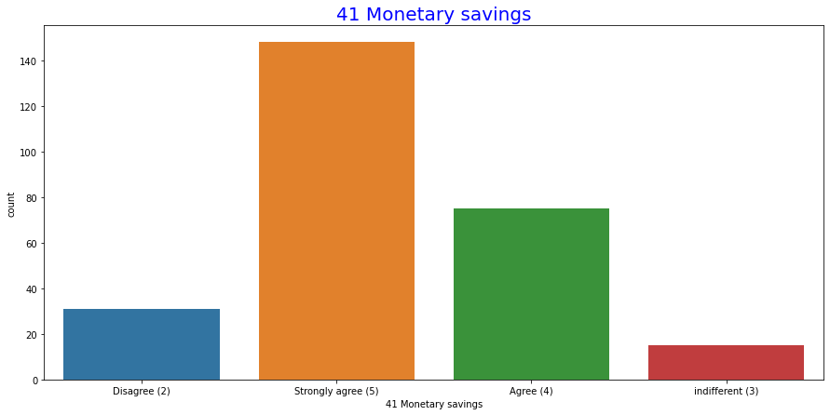
Customer Retention – Monetary Savings Analysis:-

Slide 44
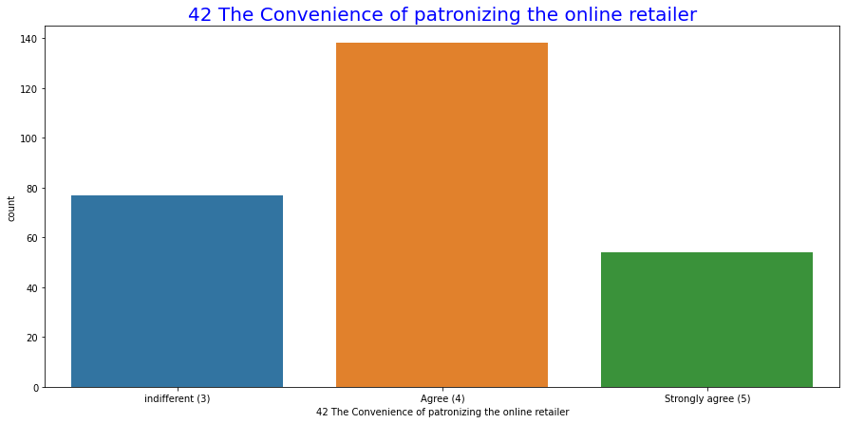
Customer Retention – Convenience Of Ptronizing Online Retailer Analysis:-

Slide 45
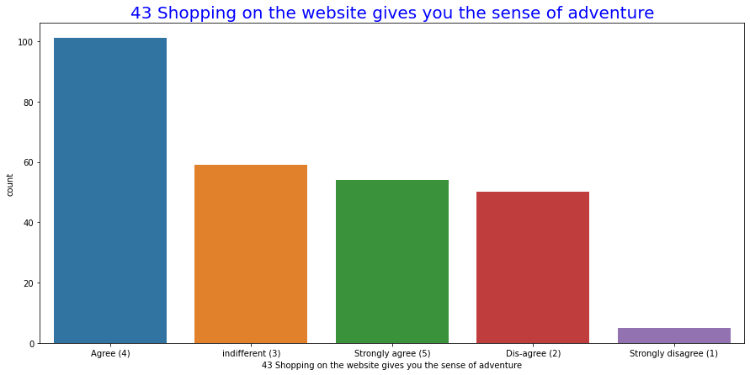
Customer Retention – Sense Of Adventure Analysis:-

Slide 46
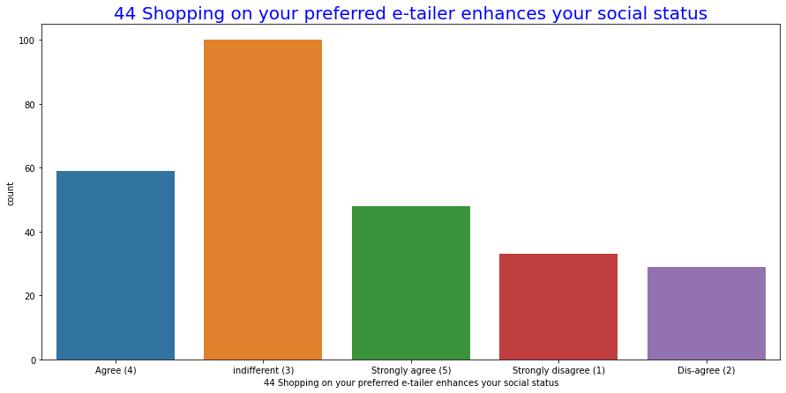
Customer Retention – Social Statuse Enhancing Analysis:-

Slide 47
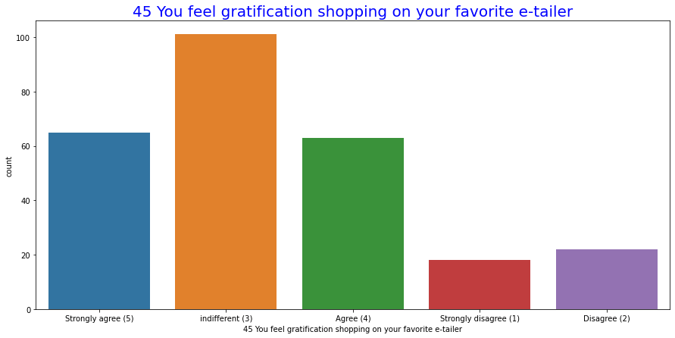
Customer Retention – Gratification feeling Analysis:-

Slide 48
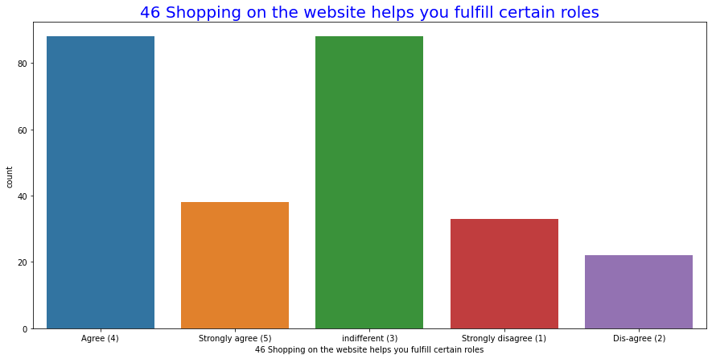
Customer Retention – Certain Role Fulfill Analysis:-

Slide 49
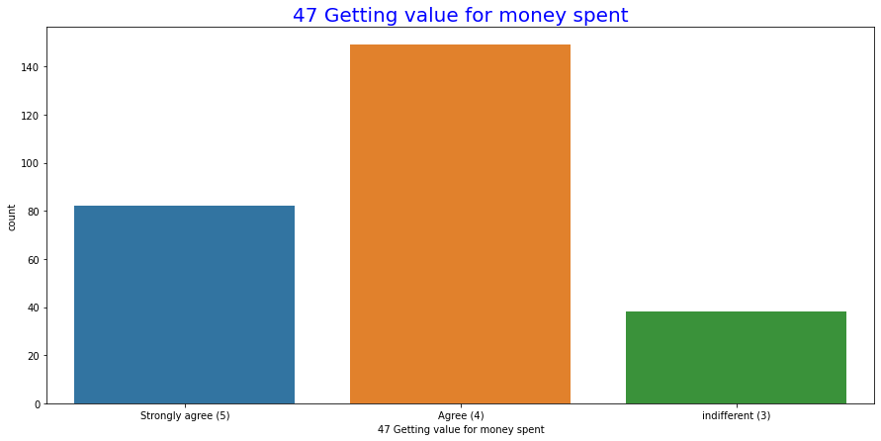
Customer Retention – Getting Value for Money Spent Analysis:-

Slide 50
Steps and assumptions used to complete the project
Project can be accomplished in the following ways through after the data visualization:
Analysis of available data types
Correlation analysis
Outlier detection
Missing values analysis
Analysis and definition of the “target” variable

Slide 51
Conclusion:
Based on the results and insights obtained regarding these steps, we have a better understanding of what variables we will be able to generate at the data preparation stage and what the system architecture will look like.

